Slide 1
Mobile Application Development
Lecture 10

Slide 2
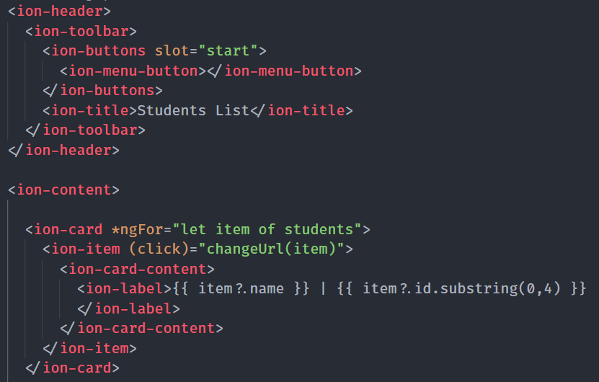
Passing Data Between Components
First of all, we need to understand what Parent, Child, and Sibling components are.
Lets, first create a component from our existing code. Here’s studentspage.page.html.
Since we might use <ion-item> somewhere else, we’ll create a component of it

Slide 3
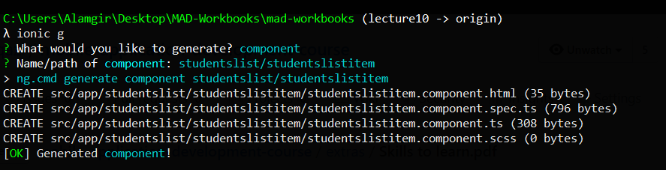
Passing Data Between Components
Lets generate a component. I typed the name as studentslist/studentslistitem because I don’t want it in App but in studentslist folder.

Slide 4
Passing Data Between Components
Lets generate a component. I typed the name as studentslist/studentslistitem because I don’t want it in App folder but in studentslist folder.

Slide 5
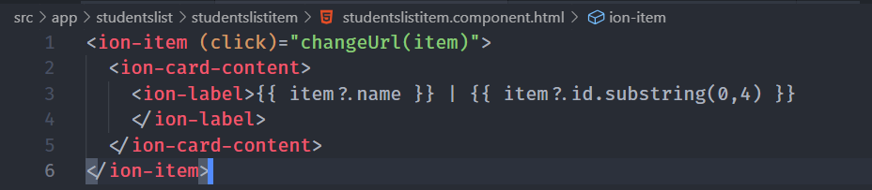
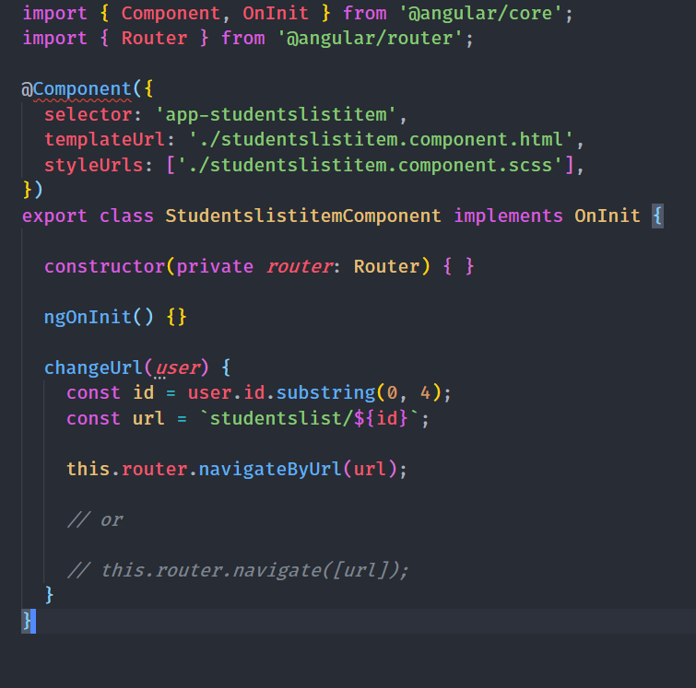
Passing Data Between Components
We move the relevant code to the new component files.

Slide 6
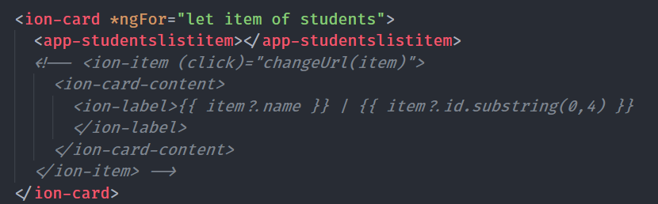
Passing Data Between Components
Here’s how the code would look like. But we have a few problems. We created a component but did not add to any module. Remember, every component belongs to some module.

Slide 7
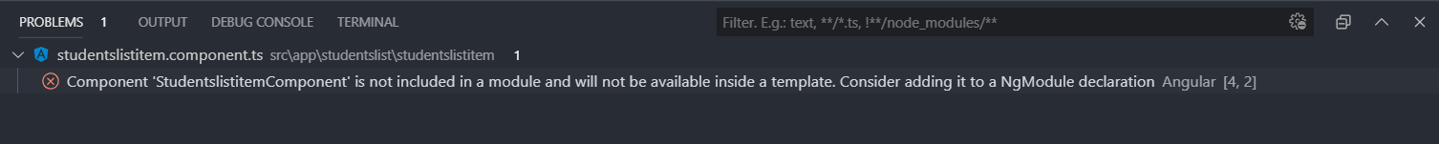
Passing Data Between Components
So we will import it in the module file of studentslist. VSCode is also telling us about the problem
Now we go to the studentslist.module.ts file and add the component into the declarations

Slide 8
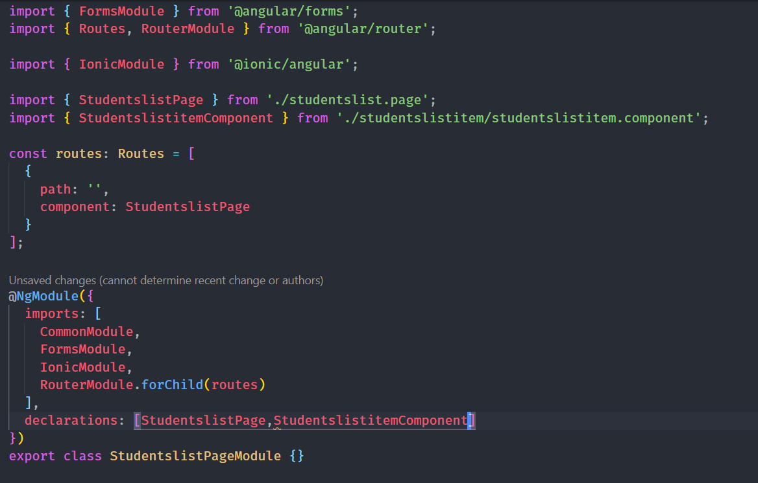
Passing Data Between Components
Just copy the class name and past it inside declarations, you will see a yellow icon, click on it and it will auto-import the file.

Slide 9
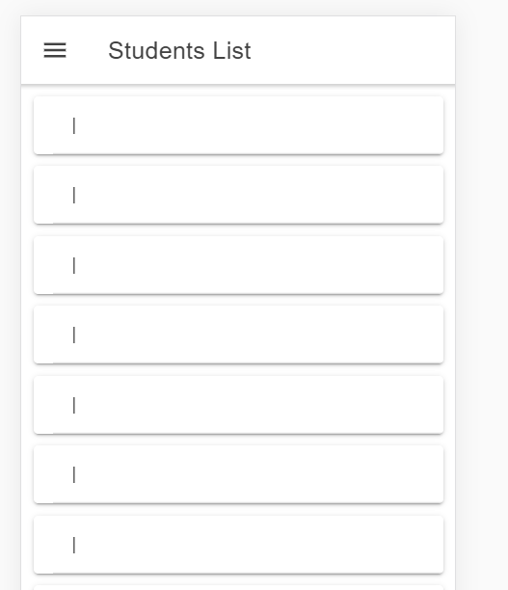
Passing Data Between Components
Now our app is working but its not displaying anything.
Why? Because we have to tell it what to display.
It has no idea what item variable is.
So we use @Input() property binding, to pass item to the component.

Slide 10
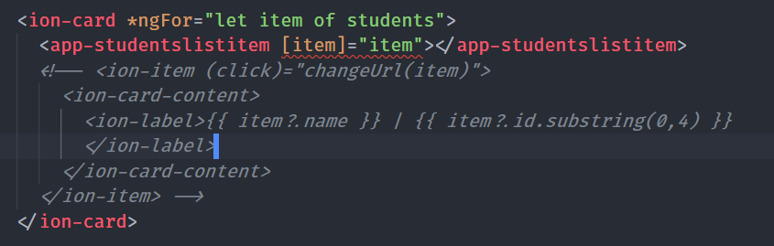
Passing Data Between Components
Now we pass via Input item variable to the component. But the linter is telling us that the component doesnot know what item is.

Slide 11
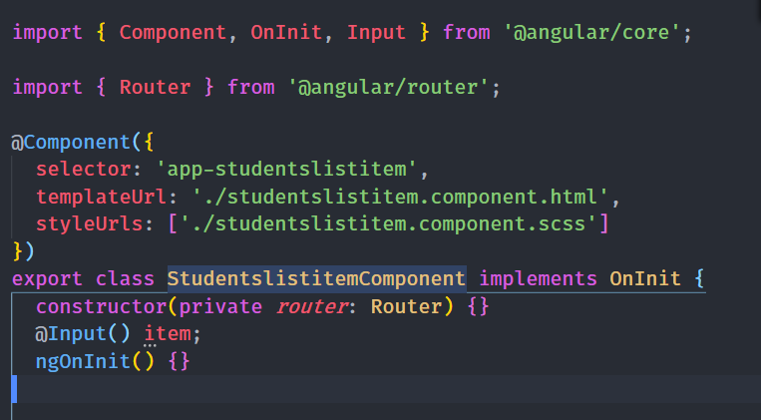
Passing Data Between Components
We create @Input() and let it know that its will be passed down from a top/higher component.

Slide 12
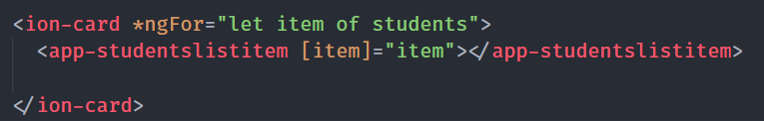
Passing Data Between Components
Now we run our application and its working the same as before.
Parent, Child and Sibling Components
Parent component are basically higher/upper component for a inner component. In our example, app-studentslist is the parent component to app-studentslistitem while it itself is child Component

Slide 13
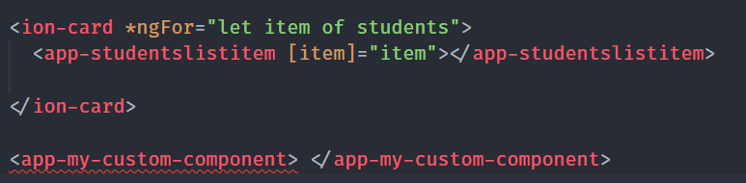
Passing Data Between Components
Sibling components are basically on the same level. Siblings mean brother/sisters. They’re the same level.
Here, app-studentslistitem and app-my-custom-component are sibling components because they’re at the same level.

Slide 14

“Only bad things happen quickly.
Virtually all the happiness-producing processes in our lives take time, usually a long time: learning new things, changing old behaviors, building satisfying relationships, raising children. This is why patience and determination are among life’s primary virtues.”

Slide 15
Passing Data Between Components
There are three major ways to pass / share data between components.
Using Input(), Output() event emitters.
Using a parents shared state.
Using an Angular Service.

Slide 16
Passing Data Between Components
Using Input(), Output() event emitters
This is ideal for parent, child components. However, once the number of components increase, this becomes hard.
Using a parents shared state
We declare the variable in the parent component and keep passing it down via Input. Can get complicated very quickly.

Slide 17
Passing Data Between Components
Using Services
This is mostly the desired approach when using Input(), Output() becomes complicated.
Using Store/NgRx
This is an option for large applications. Basically all the state is stored in one global store. We will not cover this in this course.

Slide 18
Passing Data Between Components
Review:
Parent to Child: Sharing Data via Input.
Child to Parent: Sharing Data via Output.
When passing data between components that lack a direct connection, such as siblings, grandchildren, etc, you should you a shared service. We will use rxjs alongside Services (BehaviorSubject).

